Slide 1
Final Output Demo
Part 2 Client/UI Development

Slide 2
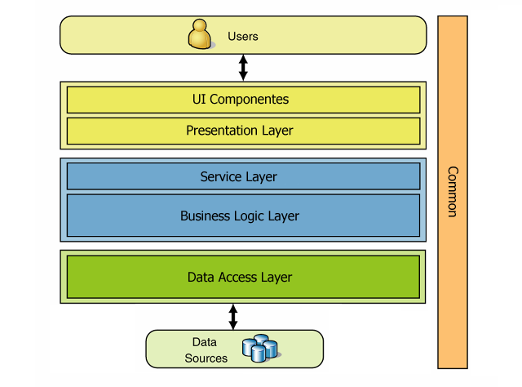
Recall the multi layer architecture approach

Slide 3
Prerequisite

Slide 4
Prerequisite
Install node.js and npm
Install electron.js

Slide 5
Node.js
Node.js is an open-source, cross-platform JavaScript runtime environment.
Node.js is free
Node.js runs on various platforms (Windows, Linux, Unix, Mac OS X, etc.)

Slide 6
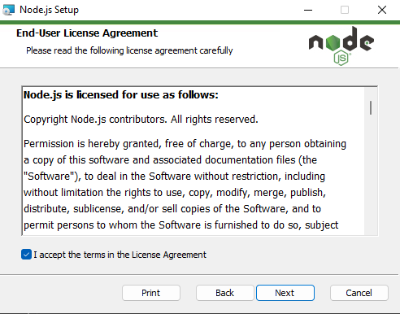
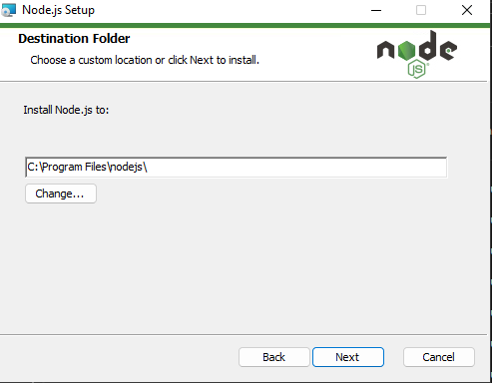
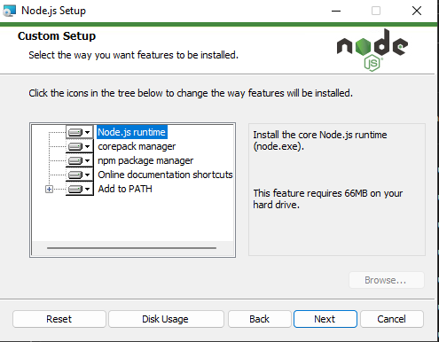
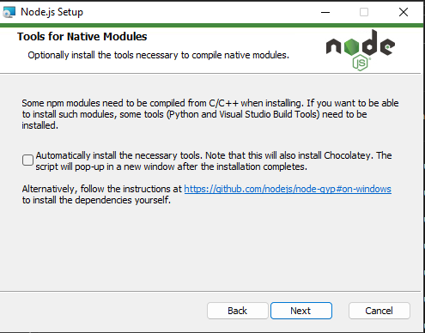
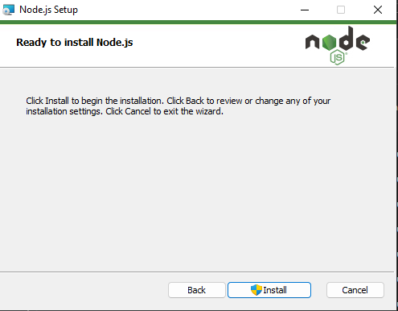
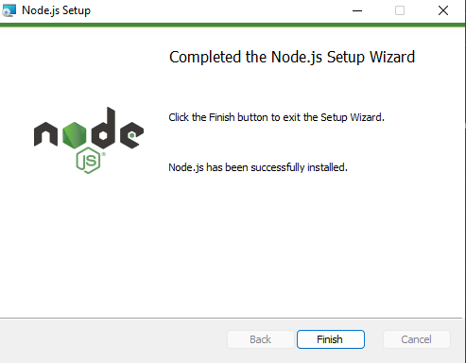
Installing node.js
Go to https://nodejs.org/en then download the LTS release of node.js
Run the installer

Slide 7
The node package manager (npm)
npm or Node Package Manager is an open-source repository of tools engineers use to develop applications and websites.
npm is two things:
A repository for publishing open-source projects. Simplified version: a digital storage and retrieval facility.
A command-line interface (CLI) for interacting with the repository. Simplified version: a tool to communicate with the storage facility.
npm typically comes with node.js installation. To check, run: npm –v
If npm, does not exist, run: npm install –g npm

Slide 8
What is Electron
Electron is a framework for building desktop applications using JavaScript, HTML, and CSS. By embedding Chromium and Node.js into its binary, Electron allows you to maintain one JavaScript codebase and create cross-platform apps that work on Windows, macOS, and Linux — no native development experience required.

Slide 9
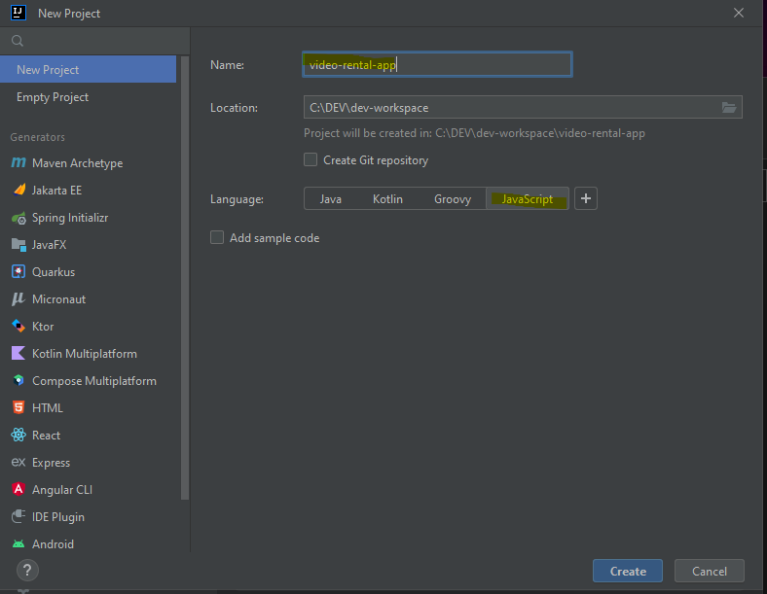
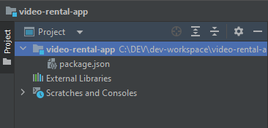
Creating the project
Create a new IntelliJ Project
Fill out the required field such as project name
Select JavaScript as Language
Click on Create

Slide 10
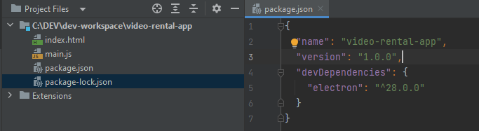
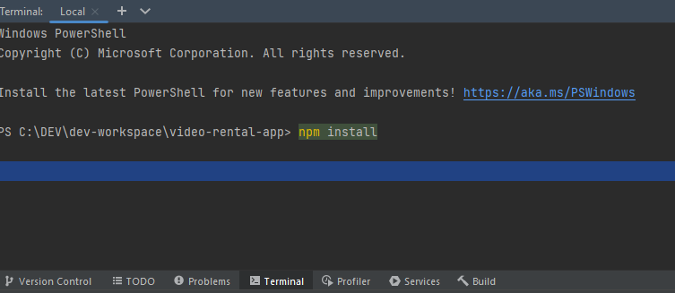
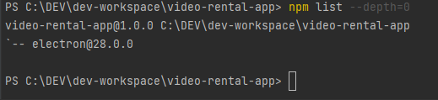
Downloading electron dependencies
On package.json, add the latest stable version of electron in the devDependencies
Then in the Terminal (ALT + F12), run npm install
Check if the installation worked, in the terminal, run: npm list -- depth=0

Slide 11
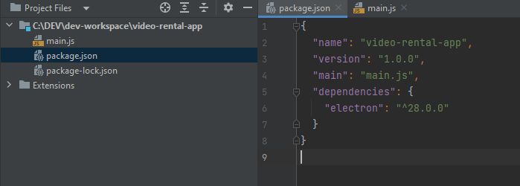
Adding the main.js file
Right click on the project name > New > JavaScript file > type main then Enter
On package.json, add the main.js as the main entry point of the electron app

Slide 12
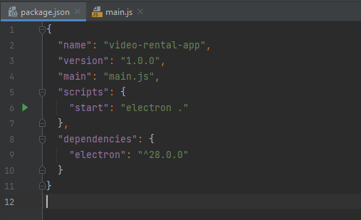
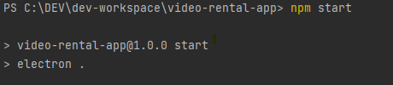
Starting the electron app
On package.json, add the following under scripts:
“start”: “electron .”
To start the electron app, run npm start in the Terminal
To stop the electron app, press CTRL + C then Y and Enter

Slide 13
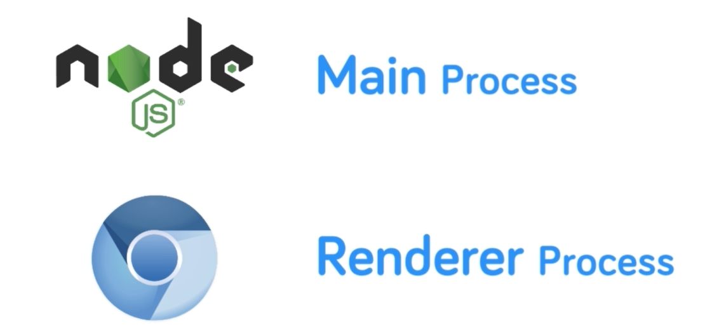
Electron Process Types
Main Process – a node.js process running with only one instance
Renderer Process (Windows) – instances created by the main process using the Chromium browser where the application front end runs

Slide 14

The Main Process
When electron is ran, it checks for the package.json file for the application entry point (main.js)
Electron launches the script as the main application process (node.js process)
In main.js, the electron.js is required using destructuring assignment to reference few submodules.
Submodules are the app itself and an instance of the BrowserWindow
BrowserWindow is used to create renderer process/es (or window/s)

Slide 15
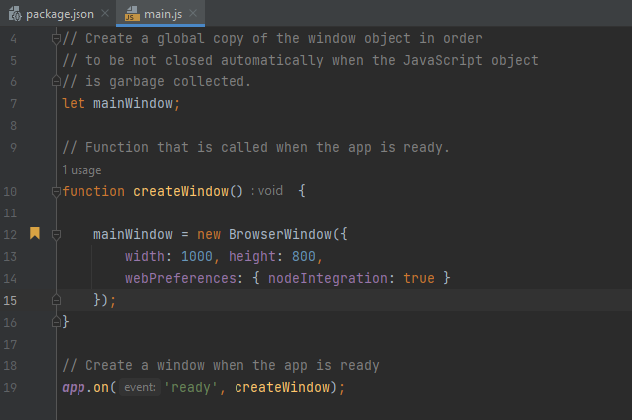
The Main Process
The app instance gets automatically created, so when the main process has started, we need to listen for the app instance to be ready
When ready, a window can be created. The app has to be always ready before attempting to create a renderer process.
A function creates a new renderer process with given parameters.
This new window should be assigned in a global window variable.

Slide 16
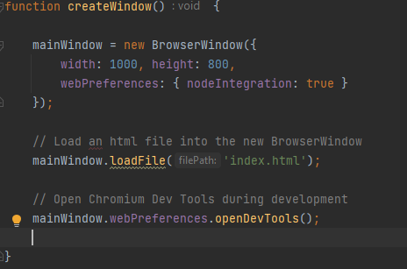
The Main Process
Right click on the project > New > HTML file > name it as index then Enter
Using the loadFile function, the main process can load any html file into the mainWindow
Chromium Dev tools can be opened and loaded using the webContents.openDevTools function for development purposes.

Slide 17
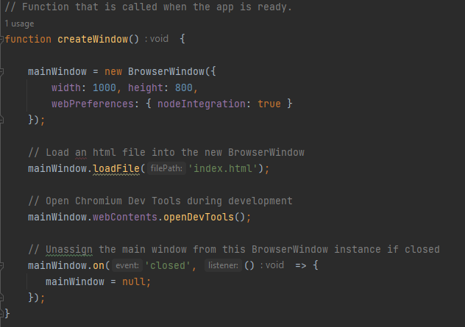

The Main Process
Add listener to the function to check when the window is closed. If closed, unassign the global window variable from the previously created window.
Add a listener to the app if all windows are closed. If they are, quit from the application.

Slide 18
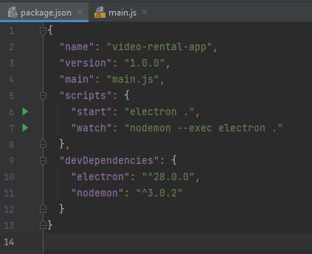
Auto updating changes in main process
In package.json,
add nodemon in devDependencies
add “watch” : “nodemon --exec electron .” in scripts
In the Terminal, run npm install to update dependencies
Update main.js process while running and see that

Slide 19
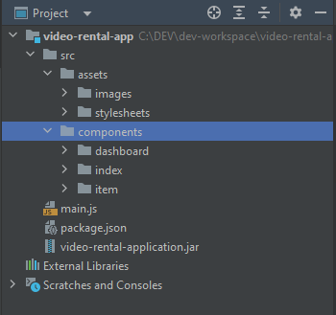
Project Structure
everything related to the main process remains in the root directory
use src directory to contain all the codes especially the renderer processes’
under src > assets, put all files that do not need compilation such as images, css files, etc
in the components section, this will contain the source files such as html and js that will represent a component/module in the project

